Slide 1
Design patterns: The command Pattern
Bui Vu Khoa – 1042108
Pham Tuan Kiet - 1042103

Slide 2
Table of contents
Definition
Use case
​Benefits
Real life examples
​Code showcase

Slide 3
Definition
Behavioral design pattern
Encapsulates and decouple
Allows the requester to specify a request via object

Slide 4
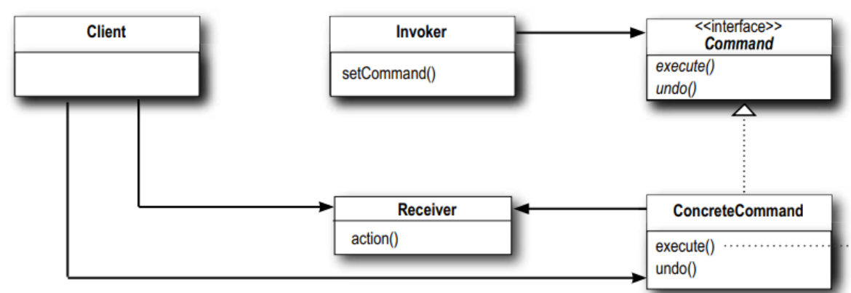
How it works
Receiver, Concrete Command and the Invoker

Slide 5




Use cases
parameterize objects with commands
support undo and redo operations
queue commands
log commands
for debugging purposes

Slide 6





Benefits
Decoupling
Extensibility
Rollback
Abstraction
Testing
Providing clear separation
Ease of component adding
Undo and redo made easier
Abstract details, simplifying code
Test individual commands in isolation

Slide 7
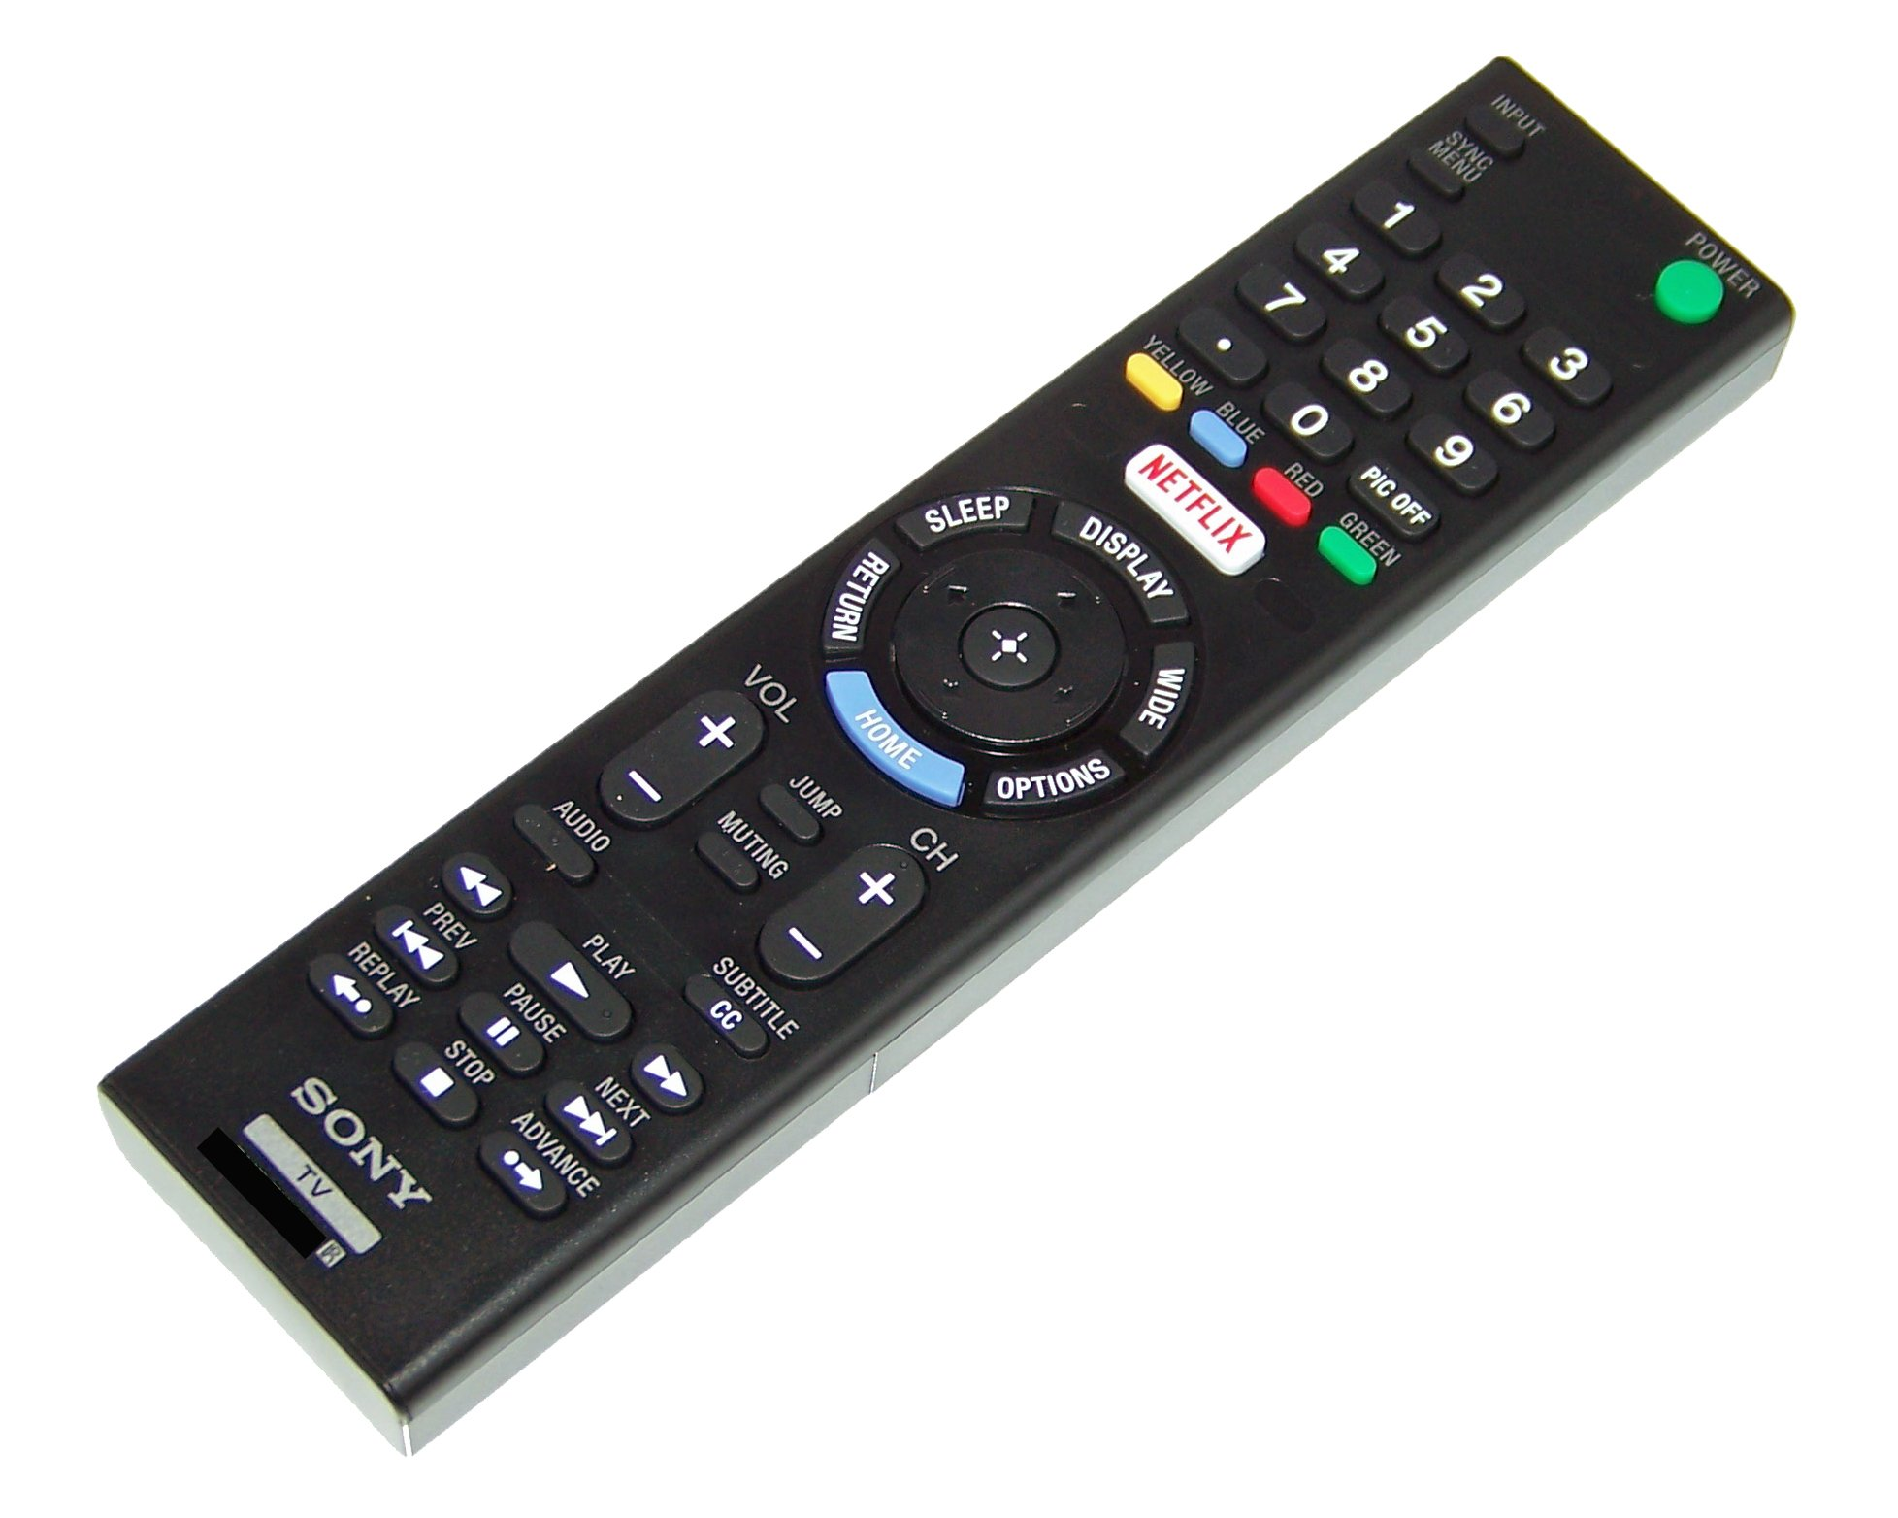
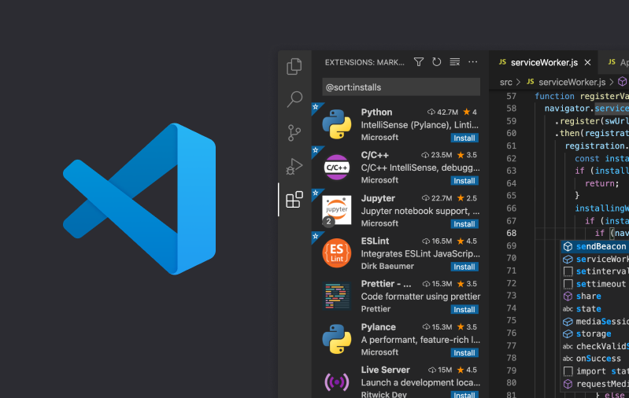
Real life examples

Slide 8
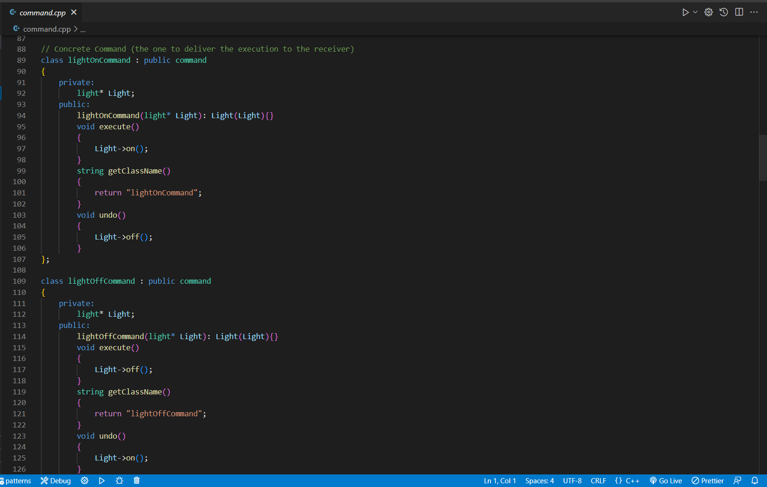
Code showcase

